Slide 1
Psychology Department
IQAC Audit, Jesus and Mary College

Slide 2
Overview
Department Profile
Teacher Profile
Students
SWOC Analysis
Future direction and Goals

Slide 3
Department Profile
Regarded as one of the best departments of Psychology in University of Delhi
Aim toward creating competent and empowered students, by providing them with holistic education.
Teachers: 13
Lab assistants : 2
Students: 162

Slide 4
Annual Departmental Activities

Slide 5
Departmental activities: 2015-2016

Slide 6
Departmental activities: 2015-2016

Slide 7
Departmental activities: 2016-2017

Slide 8
Departmental activities : Outreach
Positive Psychology campaigns (As part of competitions organised by NIMHANS)
2015: Raising awareness for mental illness, fighting stigma
2017 : Suicide prevention awareness campaign
Week long program organised in college and on social media, participation from students across all 3 years
1st prize (Shared) won by the department both times
Childhood Disorders Awareness Campaign (as part of competition organised by IMHAI and Gargi College)
2015: College wide campaign for raising awareness for Autism
Social media activation, role plays etc.

Slide 9
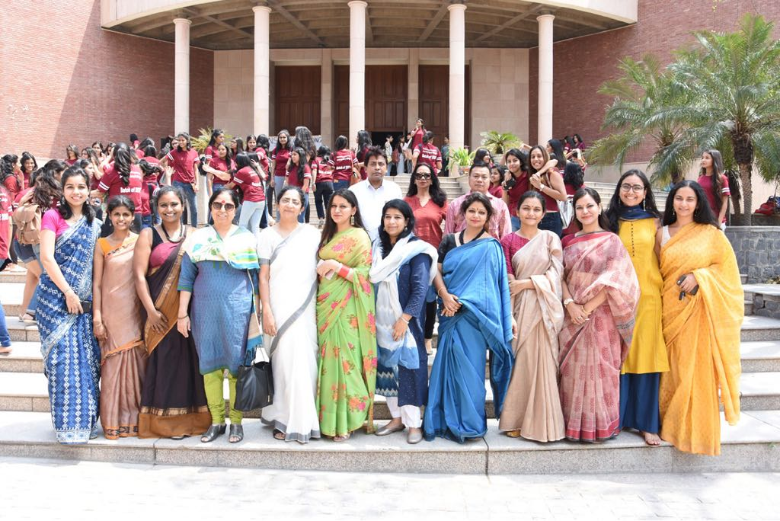
Teacher Profile

Slide 10
Composition + Qualification
Total number of teachers: 13
Permanent : 4
Ad - hoc : 9
PhD + Mphil:
PhD: 2 (?)
M.A. + NET: 7
Courses taught:
B. A (Hons.) Psychology
B. A (Prog.) Psychology courses
Generic Elective papers - other departments
Effective Decision Making- B. Voc Course

Slide 11
Research : Overview
Areas of Interest
Clinical Psychology
Social Psychology
Indian Psychology
Organizational Behavior
Developmental Psychology
Self and Identity
Cultural Psychology
Media Psychology
Mental Health
Projects: 01
Research papers: 18
Books: 01
Chapters: 04
Other publications: 06
Conference Presentations: 17

Slide 12
Dr Vinita Kshetrapal
Associate Professor, Teacher in charge (2017 - 18)
Areas of Interest: Psychoanalysis
Conference Presentations:
"The Messiah and the mis-attuned mother." Paper presented at the fifth international psychoanalytic conference.
"The Messiah and the mis-attuned mother." Paper presented at Ambedkar University Delhi. Jan 2018
"A glimpse into 'becoming O'. Paper presented at fourth international psychoanalytic conference. Jan 2017. 6-8Jan 2017. Theme... Dyads across the life cycle..an Indo Japanese conversation.
Chaired a session for third international psychoanalytic conference (Indo-Iranian) : February 2016
Invited lectures and workshops:
March 2018, Workshop on Dream Interpretation at Amity Institute of Psychology and Allied Sciences, Noida
Academic Supervision Activity:
Supervised 2 PhD theses
2015 | Shalini Masih, Co-supervised with Prof. Ashok Nagpal, Beauty in ugliness in spirit possession and exorcism - a psychosocial engagement.
2018 | Shyamolima Ghosh Choudhury, Co-supervised with Dr. Rachna Johri, New discourses on womanhood and the negotiation of feminine identity

Slide 13
Dr Ameeta Parsuram
Associate Professor, Teacher in charge (2015 - 2016, 2016 - 2017)

Slide 14
Dr Joan Antony
Associate Professor
Areas of interest: Child Psychology
Research Papers:
Ramachandran, N. & Antony, J. (2015). Children of prostitutes vs. Children of women engaged in other occupations: A comparative study on Adjustment. Journal of Research: The Bede Athenaeum, October Vol. 6, No.1(19-25).
Antony, J. (2016). Components of Academic Achievement: A Correlational S tudy between Learning Strategies and Affective Variables. Abstract published CD-ROM Conference proceedings of 2016 International Symposium on Education and Psychology, Bangkok, Thailand
Conference Presentation:
Ramachandran, N. & Antony, J. (2015). Children of prostitutes vs. Children of women engaged in other occupations: A comparative study on Adjustment. Paper presented by Ramachandran, N. at the International Conference on Work, Stress and Health: Recent Perceptions Future Trends, St. Bede’s College, Shimla, India (October 26-27, 2015).
Antony, J. (2016). Components of Academic Achievement: A Correlational Study between Learning Strategies and Affective Variables. Paper presented by Antony, J. at the 2016 International Symposium on Education and Psychology, Chulalongkorn University, Bangkok, Thailand (April 6-8, 2016).

Slide 15
Dr Joan Antony
Associate Professor
Extension Activities:
Convenor : AICUF
Talks, debates and discussions on a wide range of pertinent topics, such as women empowerment, youth, faith, among many others.
Interfaith discussions
Visits to orphanage, collection drives for providing amenities such as winter clothing, provisions, stationery, toiletries to labourers in college as well as other charitable societies around Delhi
AICUF Day (Foundress Day Celebration) - ‘Celebrating Diversity Rooted in Divinity: The Power of Faith and Prayer’ (i) Prayer by students from different Religions and a joint prayer song by students from all Religions. (ii) Followed by Faith sharing by panelists Dr.Nilima Chitgopekar, Dr.Purnima Topden, Dr. Joan Anthony, Dr.Gargi Jain, Dr.Gurmeet Bakshi and a student-Ms. Khushbhakt, speaking on Hinduism, Buddhism, Christianity, Jainism, Sikhism and Islam respectively and Chairperson Mr. Kurien Joseph.

Slide 16
Dr Shefali Mishra
Assistant Professor
Areas of interest: Indian Psychology
Research papers:
Mishra, S. (2016). Towards Positive Environmentalism: Lessons from Hinduism. Journal of Social Sciences and Linguistics, 6(2)
Pathak, V., & Mishra, S. (2017). Psychological effect of lullabies in child development. Indian Journal of Positive Psychology, 8(4), 677-680
Mishra, S., & Pathak, V. (2018). Understanding youth in the Indian context. Indian Journal of Health and Well Being, 9(2), 321-323
Lectures delivered:
‘Know thyself: An Indian perspective’, in Aryabhatta College, March 1, 2017
‘Childhood disability’, in Department of B.El.Ed, Jesus and Mary College February 2, 2018
Convenor:
Film appreciation society

Slide 17
Dr Sneh Kapoor
Assistant Professor (Ad-hoc) teaching in JMC since January 2015
Awarded PhD in May 2016 ( Clinical Psychology, All India Institute of Medical Sciences, New Delhi) : Development of Self Help Manual for Management of Obsessive Compulsive Disorder
Areas of Interest: Mental Health Awareness, Therapy outreach, Psychopathology, Gender
Research papers (2015 - 2017):
Kapoor, S., Mehta, M., & Kapoor, B. (2017). Gender differences in subtypes of obsessive compulsive disorder. Indian Journal of Health & Wellbeing, 8(6).
Chapters:
Kapoor S., Mehta M.& Sagar R. (2015) Management of Obsessive Compulsive Disorder in Adolescents. A Practical Approach to Cognitive Behaviour Therapy for Adolescents. Springer Publications.
Mehta M., Kapoor S. (2015) Academic and School Related Difficulties In SLD. Specific Learning Disability : Indian Scenario. Jaypee Publications.
Mehta M., Kapoor S. (2015) Assessment of Mental Wellbeing in Children. Postgraduate Textbook of Pediatrics. Jaypee Publications.
Mehta M., Kapoor S. (2016) Psychosocial Management of Health Problems. Springer Publications, In Press.

Slide 18
Dr Sneh Kapoor
Assistant Professor (Ad-hoc) teaching in JMC since January 2015
Awarded PhD in May 2016 ( Clinical Psychology, All India Institute of Medical Sciences, New Delhi) : Development of Self Help Manual for Management of Obsessive Compulsive Disorder
Others
Letter to the Editor: Srivastava, Paakhi & Kapoor, Sneh. (2017). Imitation Injury among Children-An Overlooked Phenomenon. The British Journal of Psychiatry. 210.
Popular Article: Psychologists as Positive Social Change Agents in India: Ideas for Action. Khabron Ka Safar (2017)
Conference Presentations (International):
123rd Annual Convention of the American Psychological Association (APA) (August 2015) – Poster Presentation: Self Help Manual Approach in the treatment of Obsessive Compulsive Disorder
International Conference on Cognitive Behavioural Interventions, New Delhi (March 2015) – Invited Lecture : Technology based CBT- Manual based Treatment for Obsessive Compulsive Disorder

Slide 19
Dr Sneh Kapoor
Assistant Professor (Ad-hoc) teaching in JMC since January 2015
Awarded PhD in May 2016 ( Clinical Psychology, All India Institute of Medical Sciences, New Delhi) : Development of Self Help Manual for Management of Obsessive Compulsive Disorder
Conference Presentations (National):
Delivered a symposium on Child Sexual Abuse: Risk and Impact, at National Trauma Conclave, at All India Institute of Medical Sciences, New Delhi (March 2018)
Others
Delivered a training on Counseling for Substance Abuse at Defence Institute of Psychological Research (September 2016)
Attended lecture on Pathological Love, by Dr Salman Akhtar , organized by AIIMS (CN Centre) in January 2018
Extension Activities
Association co-incharge, July – December 2015, Association in-charge, January – May 2016
Supervised numerous campaigns on mental health awareness and stigma, suicide prevention awareness. 2015, 2017
College activities : Publicity team – golden jubilee event of college (2017),, Core committee member – montage 2018, Member - Indian Cultural Society (2017 - 18), Film Appreciation Society (2016 - 17)

Slide 20
Ms. Bhumika Kapoor
Assistant Professor (Ad-hoc) teaching in JMC since January 2015.
Areas of Interest: Social Psychology, Organizational Behavior, Qualitative Research, Globalization, Gender
Research Papers
Kapoor, B., & Tomar, A. (2016). Exploring connections between students’ psychological sense of school membership and their resilience, self-efficacy, and leadership skills. Indian Journal of Positive Psychology, 7 (1), 55-59
Tomar, A., & Kapoor, B. (2016). Women in Indian television soap operas: A continued captivity in stereotypes. IAHRW International Journal of Social Sciences Review, 4 (2), 225-228.
Kapoor, B., (2017). Prevalence of health risk behaviors among adolescents in Delhi-NCR, India. IAHRW International Journal of Social Sciences Review, 5 (2), 245-248.
Kapoor, S., Mehta, M., & Kapoor, B. (2017). Gender differences in subtypes of obsessive compulsive disorder. Indian Journal of Health and Wellbeing, 8 (6), 515-517.
Kapoor, B., & Tomar, A. (2017). Psychosocial implications of globalization: An opportunity-based perspective. Indian Journal of Positive Psychology, 8 (2), 196-199.
Other Writing - Popular Article: Kapoor, B. (2015, March). The View from the Other Side. EducationMatters@ETMA e-Magazine, 3 (1), pp. 5.

Slide 21
Ms. Bhumika Kapoor
Assistant Professor (Ad-hoc) teaching in JMC since January 2015.
Participation in Conferences:
Presented a paper titled, ‘Understanding Globalization and its Implications for Identity’ in the 27th National Academy of Psychology (NAOP) Conference, India jointly organized by Indian Institute of Technology, Kharagpur held during December 22-24, 2017.
Participated in the Pre-Conference Workshop – Grounded Theory Method in Psychology organized by the National Academy of Psychology (NAOP) India at IIT, Kharagpur (21st December, 2017).
Achievements
Winner of a national level article writing competition in the International Seminar on ‘Value Based Life’, organized by the Department of Culture, Government of Madhya Pradesh (17-19 April, 2015).
Extension Activities
College activities: Member of Fine Arts Society (2016-2017) and Indian Cultural Society (2017-currently)
Conducted a workshop on Positive Classroom Environment with teachers from Ryan International School, Noida Extension on 27th June, 2017.

Slide 22
Ms Vrushali Pathak
Assistant Professor (ad-hoc) teaching in JMC since January 2016
Areas of Interest: Cultural Psychology, Music Psychology, Mental Health awareness, Gender
Research Papers:
Pathak, V. (2016). Role of music in understanding emotions with special reference to Shringara: a psychological exploration. International Research Journal of Management Sociology & Humanities, 7(12), 173-193
Pathak, V. (2017). 'Recovered' by the state, rejected by community: Women in partition, 1947. IAHRW International Journal of Social Sciences Review, 5(3), 551-554.
Pathak, V. (2017). Effects of intense musical experience on way of life Indian Journal of Positive Psychology, 8(2), 252-257.
Pathak, V., & Mishra, S. (2017). Psychological effect of lullabies in child development. Indian Journal of Positive Psychology, 8(4), 677-680
Mishra, S., & Pathak, V. (2018). Understanding youth in the Indian context. Indian Journal of Health and Well Being, 9(2), 321-323

Slide 23
Ms Vrushali Pathak
Assistant Professor (ad-hoc) teaching in JMC since January 2016
Other Publications:
Pathak, V. (2017). Yuvaaon ke vikaas mein sangeet ki bhoomika- ek manovaigyaanik drishtikon. Vaad Samvaad, 16
Pathak, V. (2016). What is Mental Health and Illness?. International Journal of Management, Administration, Leadership & Education, 2(2)
Pathak, V. (2017). Understanding Creativity in the context of Hindustani Music. International Journal of Management, Administration, Leadership & Education, 3(1)
Lectures:
Attended lecture on Pathological Love, by Dr Salman Akhtar , organized by AIIMS (CN Centre) in January 2018
Extension Activities:
Assisted a Senior Research Fellow in a project entitled, The musical Personalities: A Cultural journey with thumri, 2015-1017
Delivered 2 lectures in the Department of B.El.Ed, Jesus and Mary College on the topic ‘Role of Music in Self development’, 8th & 9th March, 2018
Psychology Association Assistant incharge, July – Dec 2016 and Jan – May 2017
Co-Supervised suicide prevention awareness campaign NIMHANS, 2017
College activities : Member of Indian Cultural Society since 2016

Slide 24
Ms Sumangali R.
Assistant Professor (ad-hoc) teaching in JMC since March 2016
Areas of Interest: Organizational Behavior, Social Psychology
Research Papers:
Radhakrishnan, S. (2017). More than just money: A literature review of non-financial rewards. International Journal of Education and Management Studies, 7(2), 171-176.
Radhakrishnan,S., Malik, A., Bhardwaj, J., & Prasad, S. (2017). Conflicting perspectives on homosexuality among Indian students: A qualitative inquiry. IAHRW International Journal of Social Sciences Review, 5(2), 264 - 268.
Radhakrishnan, S., & Lochan, A. (2017). Cultural intelligence: Concepts and organisational implications. International Journal of Education and Management Studies, 7(2), 191-196.
Lochan, A., & Radhakrishnan, S. (2017). What is that song about?: A psychological study of contemporary Hindi music. Indian Journal of Positive Psychology, 8(2), 214-220.
Other Publications:
Bonala, R., Jose, N., & Radhakrishnan, S. (2015). Moustaches, Machismo and Masala. In Depth, Association of Qualitative Research, UK.

Slide 25
Ms Sumangali R.
Assistant Professor (ad-hoc) teaching in JMC since March 2016
Books:
Radhakrishnan, S. (2017). The Spirit of Volunteerism: A Study of Psychological Dynamics underlying Volunteerism in India. Pragun Publications (ISBN: 9789380397726)
Lectures:
Attended lecture on Pathological Love, by Dr Salman Akhtar , organized by AIIMS (CN Centre) in January 2018
Extension Activities:
Psychology Association Assistant incharge, July – Dec 2016 and Jan – May 2017
College activities : Member of Indian Cultural Society since 2016
Provided consultancy services for Light Up, an initiative under Stanford Ignite
Delivered a lecture on Psychological skills for the contemporary world for members of Navodayam, a cultural society in Delhi Member, Publicity Team, Golden Jubilee Event of JMC

Slide 26
Ms Richa Malhotra
Assistant Professor (Ad-hoc) teaching in JMC since July 2016
Recognitions:
Recipient of the ‘Student Conference Bursary Award’ (November 2016) by Solution Focused Brief Therapy Association (SFBTA) at annual conference held in Halifax, Canada
Received the ‘Research Award’ (November 2017) by Solution Focused Brief Therapy Association (SFBTA) at annual conference held in Santa Fe, USA
Research Papers
Malhotra, R. & Suri, S. (2016). Psycho-social facets of mental health among bullied adolescents. In Iqbal. & Aleem, S. (Eds.), Psychological Issues and Interventions in health and well-being. 1(1), 399-405.
Malhotra, R. (2017). Locus of Control & Well-Being among College Students. Indian Journal of Positive Psychology. 8(2), 231-236.
Rawat, S. & Malhotra, R. (2017). Understanding Mental Health amongst Adolescents in the Indian Context. Indian Journal of Health & Well-Being. 8(5), 507-513.
Malhotra, R. (2017). The impact of Media Culture & Bullying. Indian Journal of Health & Well Being. 8(6), 562-567.

Slide 27
Ms Richa Malhotra
Assistant Professor (Ad-hoc) teaching in JMC since July 2016
Conference Presentations (International):
Participated in the annual conference (November 2016) of ‘Solution Focused Brief Therapy Association’ (SFBTA) held at Halifax, Nova Scotia (Canada)
Participated in the annual conference (November 2017) of ‘Solution Focused Brief Therapy Association’ (SFBTA) held at Santa Fe, New Mexico (USA)
Conference Presentations (National):
Attended the International Conference on Psychosocial perspectives on Health & Wellbeing (March 2016) at Jamia Millia Islamia University, New Delhi (India)

Slide 28
Dr Priya Bhatnagar
Assistant Professor (Ad-hoc) teaching in JMC since July 2017
Doctoral research in the area of ‘Cognitive Biases in Eating Disorder and Effcetiveness of Cognitive Beavioural Intervention’ under the guidance of Dr (Prof). S.P.K. Jena, Head, Department of Psychology, University of Delhi.
Completed Post Graduate Diploma in Guidance and Conselling, Jamia Milia Islamia (2017).
Pursuing Post Graduate Diploma in Counselling and Family Therapy, Indira Gandhi National Open University (since 2016).
Content writing in domain of Cognitive Psychology, e-pathshala program for post graduation in Psychology, under Ministry of Human Resource and Development.
Workshops
Malhotra, R. & Suri, S. (2016). Psycho-social facets of mental health among bullied adolescents. In Iqbal. & Aleem, S. (Eds.), Psychological Issues and Interventions in health and well-being. 1(1), 399-405.
Malhotra, R. (2017). Locus of Control & Well-Being among College Students. Indian Journal of Positive Psychology. 8(2), 231-236.
Rawat, S. & Malhotra, R. (2017). Understanding Mental Health amongst Adolescents in the Indian Context. Indian Journal of Health & Well-Being. 8(5), 507-513.
Malhotra, R. (2017). The impact of Media Culture & Bullying. Indian Journal of Health & Well Being. 8(6), 562-567.

Slide 29
Ms Annie Baxi
Assistant Professor (Ad-hoc) teaching in JMC since July 2017
Areas of Interest: Psycho-social aspects of mental health, gender, discursive psychology, qualitative methods
Conference Presentations
Being Beautiful: exploring the construct of beauty amongst Indian women.” at the International Congress of Qualitative Inquiry, University of Illinois, 2015
“Encountering the 'desirous woman': Inter-subjective and intra-psychic negotiations of the 'sexual woman” , in seminar Being and Living in the Relational World at Indian Institute of Technology, Delhi,2016.
“A Critical Review of The Mental Healthcare Bill (2016) in context of Women in Psychiatric Wards.” in National Seminar at Department of Psychology, University of Delhi, 2017
"Revisiting Prevalent notions of Empowerment: A Gender Perspective." at National Academy of Psychology Conference at Indian Insitiute of Technology, Kharagpur, 2017.
"The Shared Space." at National Academy of Psychology Conference at Indian Insitiute of Technology, Kharagpur, 2017

Slide 30
Ms Annie Baxi
Assistant Professor (Ad-hoc) teaching in JMC since July 2017
Training courses
Participated in a day long workshop on Grounded Theory by National academy of Psychology,2016.
Participated in a one and half day training workshop on “Concerns and Challenges in Doing Qualitative Research” by Department of Psychology, University of Delhi,2017
Selected for and successfully completed with project submission Advanced Certificate course in Gender Studies by Women Studies and Development Centre, University of Delhi, 2016
Participated in a week-long national workshop on “Feminist Theories and Debates” by Women Studies and Development Centre, University of Delhi, 2016.
Selected as student scholar for the prestigious two month course on ‘Researching the Contemporary’ by Centre for Study of Developing Societies, 2015.
Completed training in three-day workshop on ‘Ethnography as Qualitative method”, organized by the Anthropology Department , University of Delhi, 2015
Participated in two international workshops organized by International Congress of Qualitative Inquiry titled: “Foucault’s methodologies for Qualitative Research on the body, the self and health” & “ Exploring techniques for Interpreting, Writing Up and Evaluating Qualitative Research”, University of Illinois, United States of America, 2015

Slide 31
Ms Radhika Raturi
Assistant Professor (Ad-hoc) teaching in JMC since July 2017
Headed (author and research lead) UNICEF funded research project – understanding and assessing mental health services for child sexual abuse survivors in Mumbai in collaboration with The Foundation. Report published and distributed to all child protection agencies in December 2017. Time period july 2017 – December 2017.

Slide 32
Ms Swati Tripathi
Assistant Professor (Ad-hoc) teaching in JMC since February 2018
Areas of Interest: Organisational behaviour, organisational politics, social psychology, culture and politics.
Paper Presentations:
Presented a paper at Indian Institute of Technology, Delhi in March, 2016 on ‘Being and living in a relational world.’
Presented a paper on ‘Gender and Organizational Culture: Changing the Vantage Point’ in a seminar ‘Emerging forms of vulnerabilities: Dialogues, discources and debates’ organized by Department of Psychology, University of Delhi on 7th-10th March, 2017.
Workshops Attended:
Attended Structural Equation Modelling workshop in Allahabad in February, 2016.
Attended a workshop on ‘Challenges and concerns in doing qualitative research’ organized by Department of psychology, University of Delhi on 7th and 8th March, 2017.

Slide 33
Teaching: Innovation
Movie Screenings
Use of Audio-visual Materials
Role Plays
Classroom Activities and Debates
Intraclass Competitions
Providing Diverse Reading Material
Exposure to New Research
Gamification of learning
Use of technology portals like Schoology, PEPWeb for learning material management
Applied learning through development of campaigns and interventions
Experiential learning
Mentor-ward system

Slide 34
Student
Past students :
Progression
Research
Current Students :
Diversity
Research

Slide 35
Progression
Students pursuing degrees in India and Abroad

Slide 36
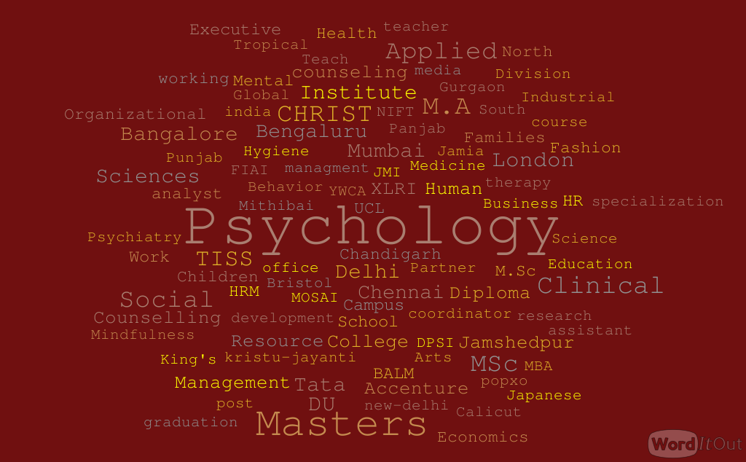

Slide 37
Research/ Achievements
Batch of 2016
Batra, A., & Kohli, S. (2016). Body Image of Buddhist Nuns. Delhi University Journal of Undergraduate Research and Innovation. 1 (2), 84-95.
Batra, A., & Kohli, S. presented and won the best paper award for paper titled - Body Image of Buddhist Nuns at Indian Association of Positive Psychology, at Manav Rachna University, Faridabad (2016).
Batch of 2017
Ray, S. (2017). A Street Child’s Perspective: A Grounded Theory Study of How Street Children Experience and Cope with Grief. The Qualitative Report, 22(1), 291-308. Retrieved from http://nsuworks.nova.edu/tqr/vol22/iss1/17

Slide 38
Department : 2015 - 2017

Slide 39
Diversity
Current strength
Total no. of students: 162
Students in 1st year : 56
Students in 2nd year: 56
Students in 3rd year : 50

Slide 40
Research
Tewatia, M. (2017). Relationship between Body Image and Self Esteem: A Study on the Male Undergraduate Students of Delhi University. International Journal of Indian Psychology, 5(1), 41-47
Udawat, A., Makkar, M., & Bharadwaj, S. (2018). Fit, Muscular and Handsome: Exploring the perceptions of body image and their impact on identity in Indian Males. Applications of Psychology: Reaching out and Making a difference. 272-283.

Slide 41
Research
Paper Presentations:
Udawat, A., Makkar, M., & Bharadwaj, S. presented the paper titled - Fit, Muscular and Handsome: Exploring the perceptions of body image and their impact on identity in Indian Males (2018) in National conference on Psychological applications and interventions: reaching out and making a difference
Mohan, S. presented the paper titled- Self Awareness enhancement techniques (2018) in IALSE International Conference, Life skills and well-being of children and youth in the digital world
Pant, S. paper titled Human psyche is in the grip of technology: Myth or reality? accepted for oral presentation at 12th International conference on Business, Education, Humanities and Social Sciences (2018)

Slide 42
Current Projects (DSE)
Discovering the nature of domestic violence as a journey
Fear of happiness
Understanding the experiences of having a female body
Understanding distress of transgenders
Understanding the idea of Romance in today's world
Brinda Singh Raikwar
Chelsea Dean
Farhat Khan
Kirti Singhal
Maanya Tewatia

Slide 43
Current Projects (DSE)
The gender differences in coping strategies of juveniles' parents
Mansi Dougall
Performance of Masculinity in Male friendships
Mehar Makkar
Associative stigma among healthcare professionals
Ria Bhargava
Impacts of sports on developing identities of young girls
Sanskriti Bhardwaj
Understanding experiences of agency in urban Indian millennial women
Sharin D'souza

Slide 44
DSE Project in psychology offered to B.A Programme
Yashvi Panjrath: Under the supervision of Dr Shefali Mishra
Title: Autism and the Parents : The lived experience

Slide 45
Department

Slide 46
Students
Intellect, curiosity, creativity
Alumni who are currently doing very well in various fields
Resources
Functional laptops
Projectors
Books
Active participation in college, intercollegiate and outreach activities
Part of various cultural and co-curricular societies in college
SWOC : Strengths

Slide 47
Teaching
Use of innovative teaching methods
Teacher Diversity - varied interest areas and backgrounds, diverse and richer perspectives in the classroom
Effective support staff
Opportunities for application - innovative practicum designs, real world applications of theoretical concepts
Co – curricular
Regular arrangement of diverse curricular and extracurricular activities
Encouragement of student research, guided by faculty members
Regular outreach activities
Development of critical thinking - classroom and tutorial discussions on a range of current and critical issues
SWOC : Strengths

Slide 48
Students
Absence of a stronger alumni network for ensuring better placement opportunities for current students
Student burnout - heavy workload, particularly practicum work, shorter duration of semesters adds to perceived stress among students
Resources
Lack of high-speed internet connection for allowing the use of internet in classrooms for classroom activities
Outdated apparatus/instruments for testing and experiments
Teaching
Fewer number of permanent faculty
Higher teacher workload
SWOC : Weaknesses

Slide 49
Opportunities
Skill based trainings and workshops, Career-development series
More outreach activities
Use of more updated technology to facilitate teaching.
Organisation of conferences and seminars
Opportunities for students to showcase work - magazine/ psychology journal
Challenges
Limited resources - lab and tutorial space, infrastructure, access to journals, latest research
Limited funds for organising conferences, procuring resources and lab development
Mental health concerns among students
Large group sizes in practicum/ tutorial - may impact time and guidance given to students
SWOC : Opportunities and Challenges

Slide 50
Goals : Future Direction
Field work/ field trips to allow for real life exposure to different settings in psychology
Engaging in outreach work, community skill building programs
More focus on research, Innovation projects
Better pool of resources for psychometric assessment
Stronger alumni network
Lab development

Slide 51
Thank You

